Slide 1

MongoDB

Slide 2
About Mongo
Document based DB
User-defined JS functions
Capped collections
Aggregation
File Storage

Slide 3
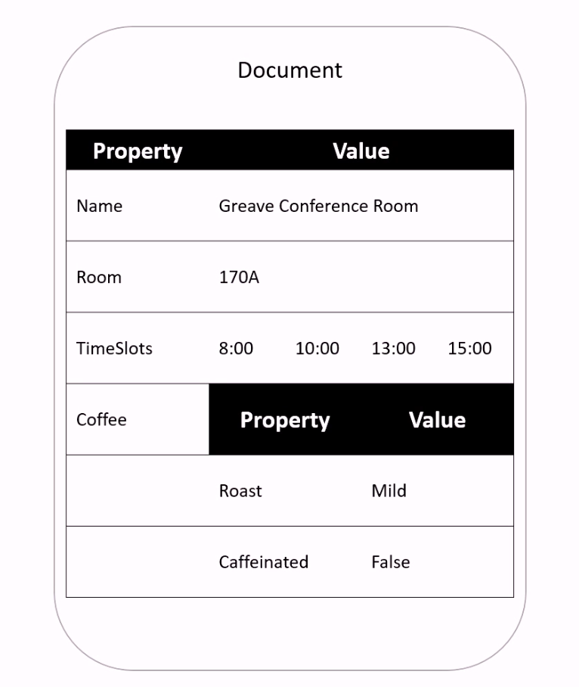
Document

Slide 4
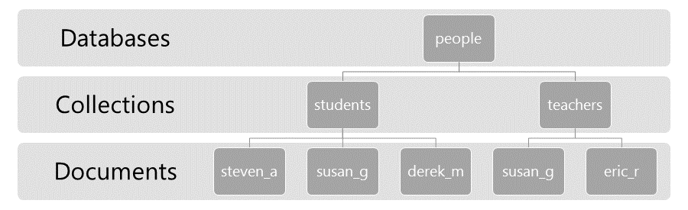
Data Model

Slide 5
Capped collections
Collection cap.: 4
3
4
2
2
3
1
5
4
5

Slide 6
Quiz
What is a Document?
Where JS can be applied?
Where capped collections could be useful?

Slide 7
Vocabulary
Word | Definition | Examples
neatly | In a tidy way | Each of the girls was dressed neatly.
get hairy | To go in a bad way | If you shot an armed intruder, this is going to get hairy.
ad-hoc | designed for a specific solution | In addition, he wanted more clarification about ad-hoc authorization.

